Slide 1



Python is an interpreted high-level programming language for general-purpose programming
Guido van Rossum
Named after famous British comedy show

Slide 2
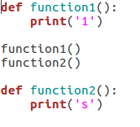
Interpreter Language
What will it print?
An interpreted language is a type of programming language which execute instructions line by line without previously compiling a program into machine-language instructions.
We can run python interactiinteractively,
we can type a line
of Python (a sentence) and Python processes it immediately and is ready for us to
type another line of Python.
The first interpreted high-level language was Lisp. Lisp was first implemented in 1958 by Steve Russellon an IBM 704 computer
The Python interpreter is written in a high-level language called “C”

Slide 3
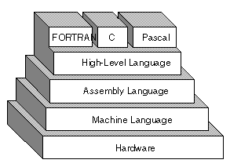
High Level Language
A high-level language (HLL) is a programming language that enables a programmer to write programs that are more or less independent of a particular type of computer. Such languages are considered high-level because they are closer to human languages and further from machine languages.
In 1954, language FORTRAN was invented at IBM by a team led by John Backus

Slide 4
General Purpose Programming
Need a script to automate part of your workload ? Python is there for you
Need to setup web page and/or web service ? Python is there for you
Want to take a better look at your data and make analysis on top of it? Python is there for you
In computer software, a general-purpose programming language is a programming language designed to be used for writing software in the widest variety of application domains
No formal definition of general programming language – language which is Turing complete is regarded as general purpose
HTML - markup

Slide 5
Building Blocks of Programs
Read Input
Process Input
Output
Input
Files-txt,
csv,
User Input
Variable
Statement
Datatype -List,
Set,Tuple,
Dict,String
Functions
Conditions
Iteration
Database
Visualization

Slide 6

User Input
Asking the user for input
Python provides a built-in function called input that gets input from the keyboard When this function is called, the program stops and waits for
the user to type something. When the user presses Return or Enter , the program
resumes and input returns what the user typed as a string.
Converting User Input
If we want to read a number from the user, we must convert it from a string to a number using a type conversion function

Slide 7
Working with Text File
Before we can read the contents of the file, we must tell Python which file we are going to work with and what we will be doing with the file.
This is done with the open() function open() returns a file handle a variable used to perform operations(read,write,close) on the file.
handle = open(filename,mode)
LogFile = open(‘log.txt’,’r’)
Data = LogFile.read()
LogFile.close()
LogFile = open(‘log.txt’,’w’)
LogFile.write(data)
LogFile.close()
Mode – r – Reading
w – Writing
a – Append

Slide 8
Working with CSVFile
import csv
with open('example.csv') as csvfile:
readCSV = csv.reader(csvfile, delimiter=',')
import csv
with open('some.csv') as csvfile:
writer = csv.writer(csvfile)
writer.writerows(data)

Slide 10
Reserved Words
You cannot use reserved words as variable names / identifiers
and del for is raise assert elif from
lambda return break else global
not try class except if or while
continue exec import pass yield def
finally in print as with

